Slide 1
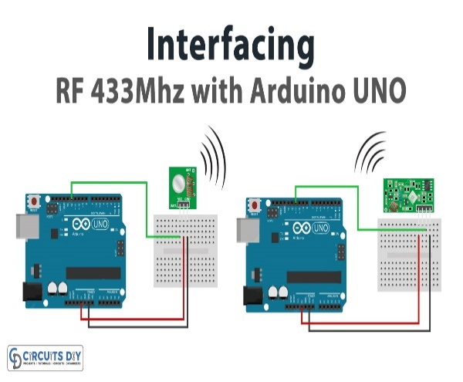
RF communication using Arduino
Project By : Siddharth Mehrotra – 12006050
Shivam Rai – 12018182
Palvai Manoj Kumar – 12009417
Reetesh Kumar - 12010632

Slide 2
CONTENTS.
INTRODUCTION
PROBLEM TO BE SOLVED
HARDWARE & SOFTWARE REQUIREMENTS
FEATURES
CIRCUIT DIAGRAM
VIDEO
CONCLUSION

Slide 3
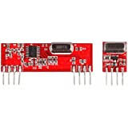
INTRODUCTION
The RF 433MHz Transmitter/Receiver Module with Arduino project is a cost-effective solution for wireless communication between Arduino boards, using RF transmitter and receiver modules with a range of up to 100 meters.
The project is compatible with various types of Arduino boards, and can be used in a wide range of applications such as home automation, security systems, robotics, and remote control systems.
To implement this project, you need to connect the RF transmitter and receiver modules to the Arduino board, upload the code to the Arduino board using the Arduino IDE, and use one of two popular libraries (Virtual Wire or RCSwitch) to send and receive data wirelessly.
Overall, the RF 433MHz Transmitter/Receiver Module with Arduino project provides a simple and valuable skill for anyone interested in electronics or robotics.

Slide 4

CIRCUIT DIAGRAM

Slide 5

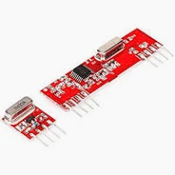
HARDWARE REQUIREMENTS
Arduino board
RF 433MHz Transmitter Module
RF 433MHz Receiver Module
Jumper wires
Breadboard (optional)
Power supply
SOFTWARE
REQUIREMENTS
Arduino IDE
Virtual Wire library
RCSwitch library

Slide 6

FEATURES
Compatibility: The project is compatible with Arduino boards and can be easily integrated into any Arduino project.
Easy to use: The project is easy to use and requires no complex wiring or programming. The transmitter and receiver modules can be easily connected to the Arduino board using jumper wires.
Range: The transmitter and receiver modules have a range of up to 100 meters, making it suitable for long-range applications.
Data transmission: The project can be used to transmit data wirelessly between two Arduino boards or between an Arduino board and other wireless devices such as remote controls.
Low cost: The project is relatively low cost compared to other wireless communication modules, making it a cost-effective solution for wireless communication.
Flexibility: The project can be used in a wide range of applications, including home automation, security systems, robotics, and remote control systems.

Slide 7
PROBLEMS to be solved
Control devices wirelessly using a remote control system.
Transmit data wirelessly from sensors such as temperature and humidity sensors.
Automate home appliances and devices using a smartphone or remote control.
Control robots wirelessly using an RF transmitter and receiver.
Detect intruders or suspicious activity using a wireless security system.

Slide 8
VIDEO Demonstration

Slide 9
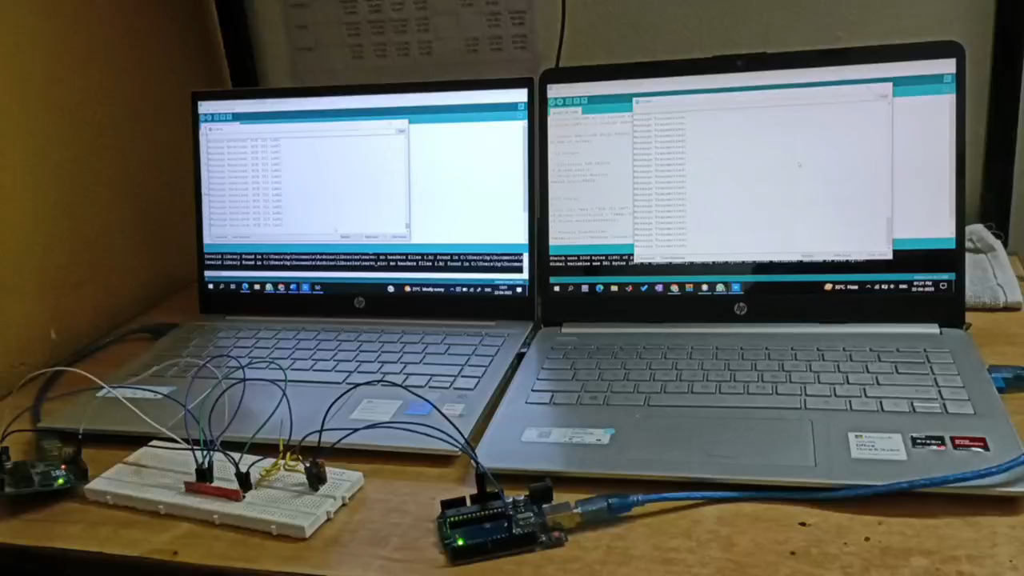

Slide 10
CONCLUSION
In conclusion, the RF 433MHz Transmitter/Receiver Module with Arduino project provides a cost-effective solution for wireless communication between Arduino boards, with a range of up to 100 meters. The project can be used in various applications, including remote control, home automation, robotics, and security systems.
By learning how to implement this project, you can gain valuable skills in wireless communication and electronics, while also creating useful projects that can solve real-world problems.
Overall, the RF 433MHz Transmitter/Receiver Module with Arduino project is a great way to learn about electronics and wireless communication, and can help develop your skills in Arduino programming and project implementation.

Slide 11


